Slide 1


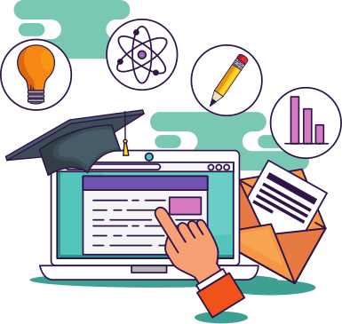
BANSAL INSTITUTE OF SCIENCE AND TECHNOLOGY, BHOPAL
How Technology
is Changing Education
A look at the importance of technology
in teaching and learning
Submitted To:Bhavana Shirke
Submit : jayant Vishwakarma

Slide 2

The Impact of Technology on Teaching and Learning
Technology is a powerful tool that has changed how teachers teach and how students learn. It has provided people with access to education and access to different ways of communicating and working together.

Slide 3




Traditional Teaching and Learning | Teaching and Learning with Technology
Physical learning materials and equipment like paper, pens and chalkboard Limited access to education materials and information Teaching and learning typically occurs in an in-person classroom setting | Wider access to education materials and information More available channels and tools for communication as well as collaboration Enables a more personalized kind of learning for students

Slide 4

The Role of Interactive Technology in Learning
INTERACTIVE TECHNOLOGY OPENS UP
THE WAY WE TEACH AND LEARN
Interactive technology helps create opportunities for communication. It can encourage teachers and students to communicate more, share and discuss ideas, and collaborate
with each other.

Slide 5
Benefits to teachers
HOW TECHNOLOGY HELPS TEACHERS
DO THEIR WORK
Allows teachers to be more flexible | Helps teachers connect more with students | Allows access to more resources
Teachers can use different teaching methods and tools to suit their lessons or students. | Teachers are able to better communicate with their students and support them in their learning | Teachers are able to find additional and updated learning resources that can help them with their work

Slide 6
Allows for a more personalized learning experience
Students have more freedom to choose the methods and tools that help them learn best.
Improves students' communication skills
Students have access to different channels where they can communicate and collaborate with teachers and fellow students.
Helps students prepare for the future
Students become equipped to face a highly technological future and will be able to easily adapt.
Benefits
to Students
HOW TECHNOLOGY HELPS STUDENTS LEARN

Slide 7

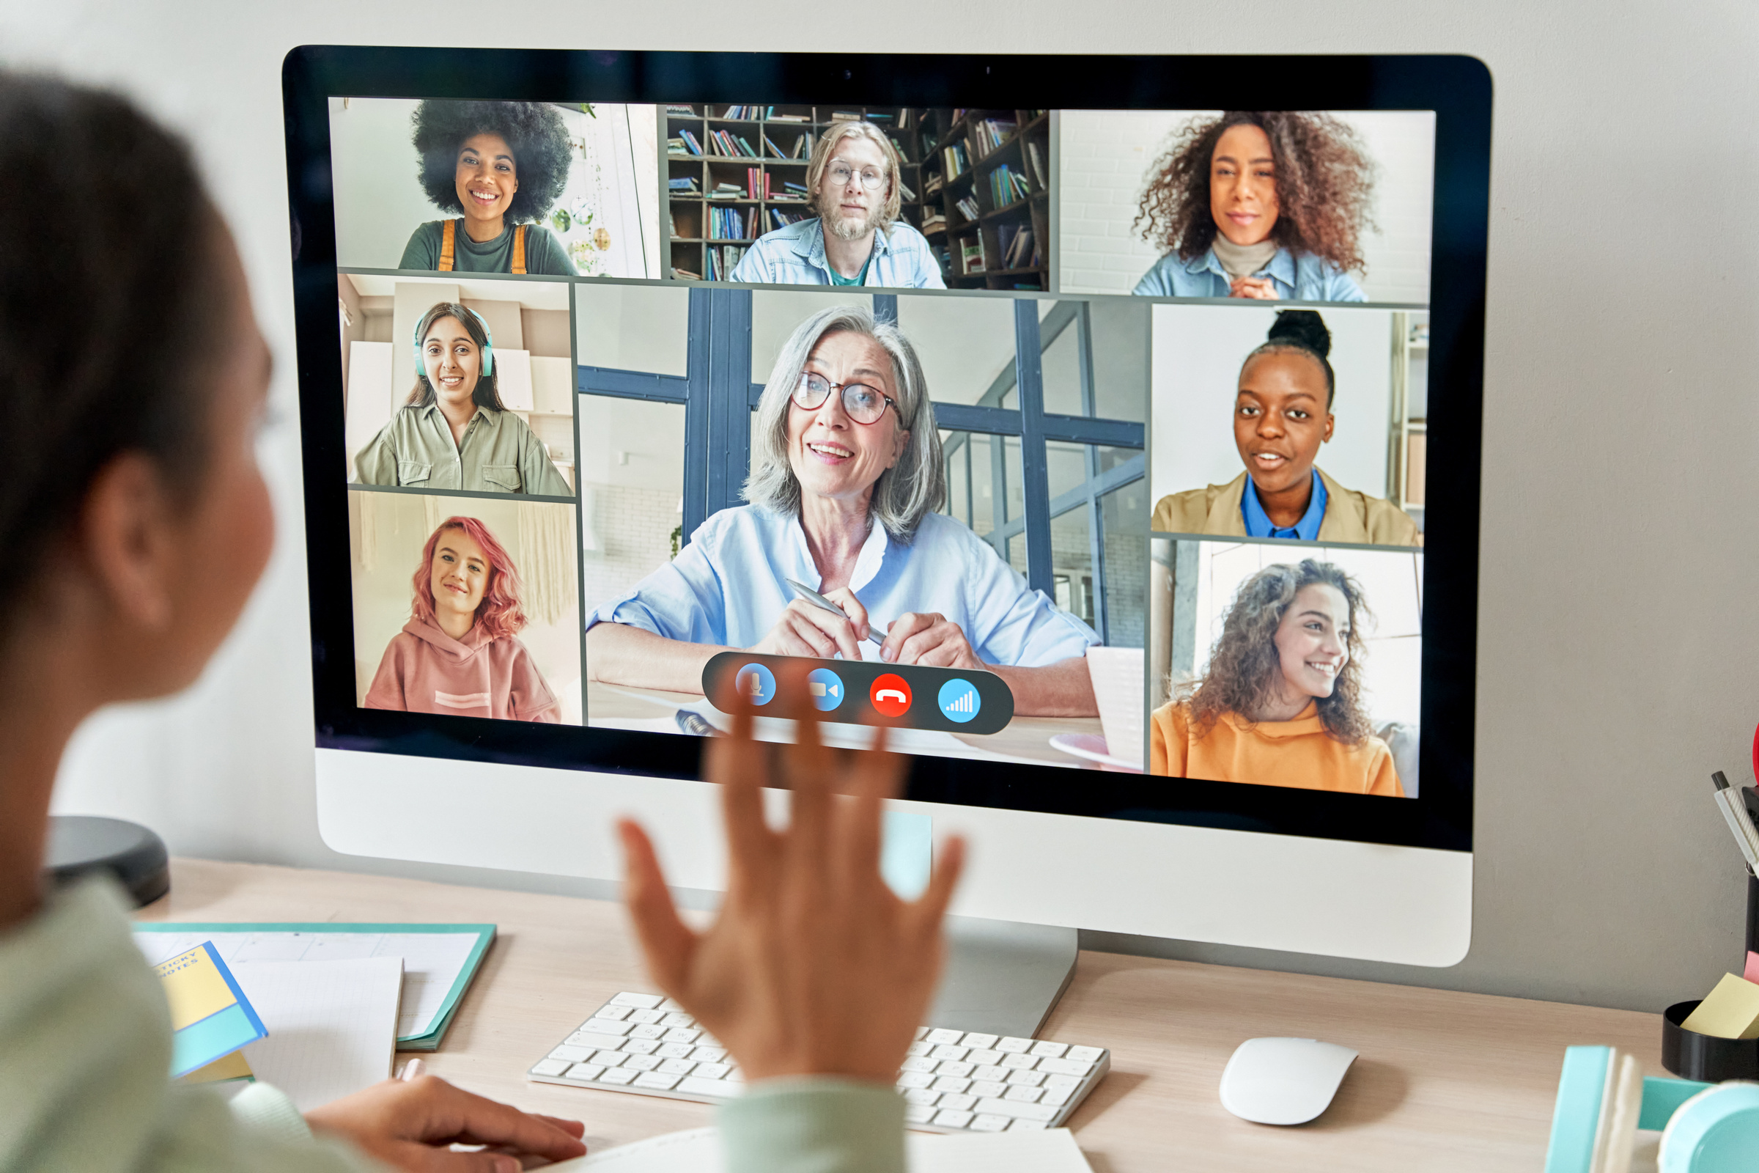
Remote learning as the new normal
IT'S IMPORTANT RIGHT NOW
BUT IS IT THE FUTURE?
Remote learning technology has been crucial to education right now, and it will likely be as critical in the future as schools determine the best way they can move forward. Schools can adopt or offer a combination of remote and in-person learning.

Slide 8




Technology is an effective tool that can make education more meaningful and engaging for teachers and students alike.

Slide 9

Thank you

